Slide 1

Exploratory Data Analysis and Spatial Visualization of Crime Data in
New York City
Team :
Naga Badra Kali Mylavarapu : 2183705 Yaswanth Chowdary Pavuluri : 2183774
Rohith Reddy Depa : 2295660

Slide 2
CONTENTS
INTRODUCTION
BACKGROUND
MOTIVATION
GEOPANDAS & related concepts.
VISUALIZATION
OUTPUT DEMO
REFERENCES
CONCLUSION

Slide 3
INTRODUCTION
The objective of this project is to analyze and visualize the geospatial distribution of crimes across the boroughs of New York City using the New York City crime/offense dataset. In addition to creating informative geoplots using GeoPandas, the project aims to identify and address specific challenges and issues within the dataset.

Slide 4
BOROUGHS – NEW YORK CITY
The Boroughs of New York City are the five major governmental districts that compose New York City. They are,
Bronx
Brooklyn
Manhattan
Queens and
Staten Island.

Slide 5
MOTIVATION
Major Motivation for this project is understand the geo-communication system adapted in police department and how they mobilize when offence takes place in a particular location.
Other Applications:
These concepts also used in traffic congestion avoidance and E-commerce delivery system
To identify hard-to-reach student in educational institutions.

Slide 6
GEOPANDAS
GeoPandas is a widely used open-source library for working and manipulating geospatial data in Python.
It extends the functionalities of a pandas dataframe, thereby making it possible to handle spatial data within pandas.
GeoPandas combines the power of pandas with ‘Shapley’.
Shapley is a Python package for manipulation and analyzing geometric objects in the Cartesian plane.

Slide 7
GEODATAFRAME
A GeoDataFrame object is a pandas.DataFrame that has a column with geometry values.
Latitude-Longitude data is the collective term used with projection on plot to pin-point a specific place. This is called EPSG (European Petroleum Survey Group).
This represents Earth as a three-dimensional ellipsoid. It's used in Google Earth and GSP systems.
EPSG is a database of Coordinate Reference Systems (CRS) and related information. It assigns codes to various geodetic parameters, ensuring that coordinates describe positions unambiguously.

Slide 8
Co-Ordinate Reference System
The fundamental functionality of spatial distribution using GeoPandas is CRS.
GeoPandas allows you to specify a CRS for your GeoDataFrame, which defines the coordinate system used for the geometries. This is crucial for accurate spatial operations and mapping.
CRS tells Python how those coordinates relate to places on the Earth. It provide a standardized way of describing locations on earth.
Integration with Other Libraries:
GeoPandas can be used in conjunction with other geospatial libraries, such as Folium for interactive maps, and tools like Fiona and Shapely for additional geospatial functionality.

Slide 9
CRS - WSG84
The World Geodetic System (WGS 84) is a 3-dimensional coordinate reference frame for establishing latitude, longitude and heights for navigation, positioning and targeting.
The WGS84 CRS has become a global standard for latitude and longitude positions, such as those captured with GPS devices.
WGS84 is the popular CRS used in armed forces and police departments to identify or spot the exact locations.

Slide 10
VISUALIZATION

Slide 11
PROCEDURE
In GeoPandas, the 'geometry' column is a special column that is used to store geometric objects such as points, lines, and polygons (Location co-ordinates in project). This column is a fundamental feature of a Geo-Dataframe and this is what differentiates it from a regular Pandas Dataframe.
Once you have a Geo-DataFrame with a 'geometry' column, you can perform various spatial operations.
Examples of spatial operations include:
Buffering: Creating a buffer around geometries.
Intersection, Union, Difference: Operations that compare or combine geometries.
Distance Calculations: Calculating the distance between geometries.
These operations are carried out using the Shapely library, which GeoPandas relies on for geometric manipulations.

Slide 12
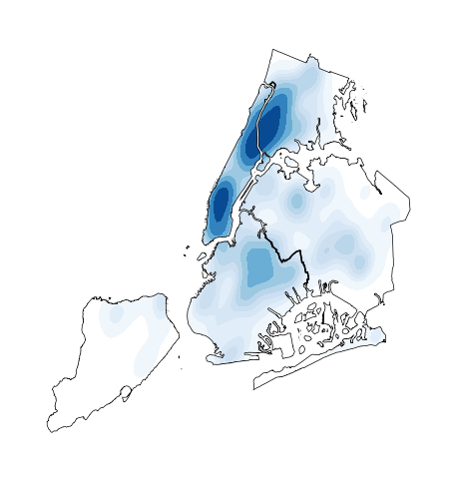
DEMO

Slide 13
CONTRIBUTION
Rohith Reddy Depa : 2295660 - Data Loading and Data Exploration,GeoPandas Integration,Boroughs Visualization Using Plotly Express
Naga Badra Kali Mylavarapu : 2183705 - Temporal Analysis of Crime Incidents,Demographic Insights from Crime Data
Yaswanth Chowdary Pavuluri : 2183774 - Advanced Visualization of Crime Patterns,Correlation Analysis and GeoMapping Insights

Slide 14
CONCLUSION
We summarize this project by getting a strong understanding on the concepts of spatial distribution using GeoPandas.
Implementation of classes like choropleth and geodatasets.
Real-world applications of these implementations.
Now, we are majorly working on report and wrapping the project with minor tasks to visualize the details of offence.

Slide 15
REFERENCES
https://educationcommission.org/updates/five-ways-geospatial-analysis-can-help-visualize-and-solve-some-of-educations-biggest-challenges/
https://geopandas.org/en/stable/docs/user_guide/projections.html
https://www.google.com/search?q=WGS84&rlz=1C1GCEA_enUS1081US1082&oq=WGS84&gs_lcrp=EgZjaHJvbWUyBggAEEUYOdIBBzM2NGowajmoAgCwAgA&sourceid=chrome&ie=UTF-8
https://geopandas.org/en/v0.10.2/getting started/introduction.html#Concepts
https://towardsdatascience.com/interactive-geographical-maps-with-geopandas-4586a9d7cc10

